Slide 1
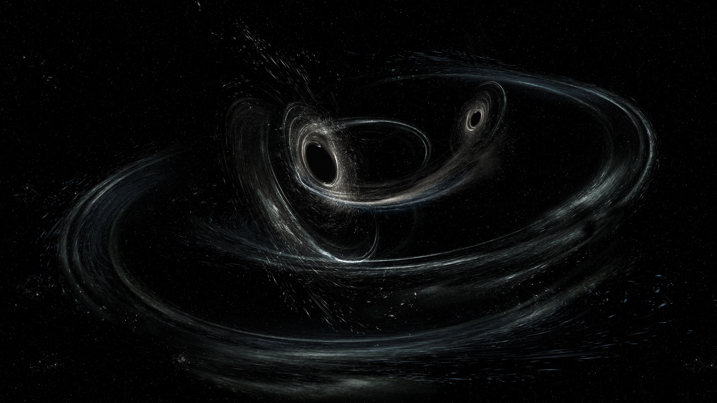


Gravitational wave signals from precessing bbH inspirals
Tamanjyot Singh
Evangelos Stoikos, Saif Ali
Michael Kesden, Lindsay King
The University of Texas at Dallas
APS April meeting 2024, Sacramento
04/05/2024
Image credit: LIGO/Caltech/MIT/Sonoma State (Aurore Simonnet)
Notes:
PHY-2011977 and PHY-2309320

Slide 2
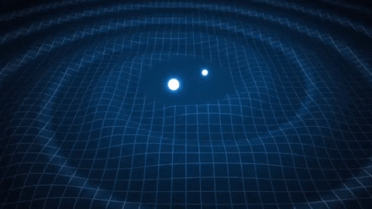
Outline
GWs: Polarizations
Precession in BBH
  Precession model*
  Effects of the parameters on strain
Mismatches: Distinguishability
Conclusion
*Inspiral-only waveforms: quasi-circular orbits for equal mass binaries.
04/05/2024

Slide 3
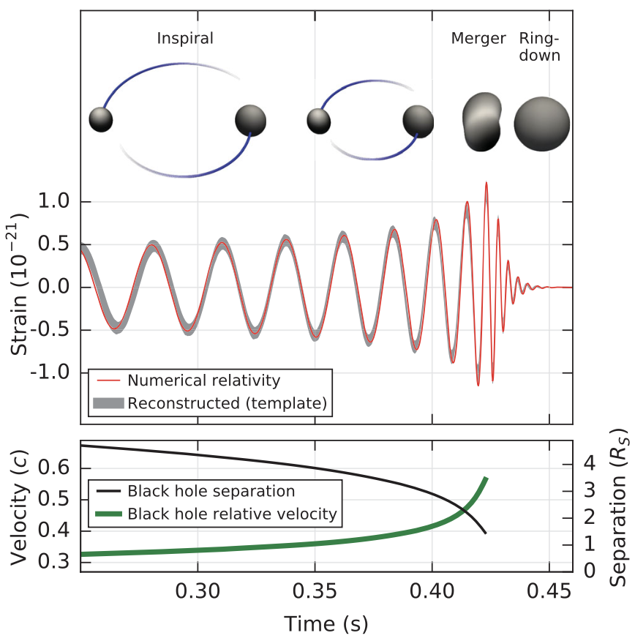
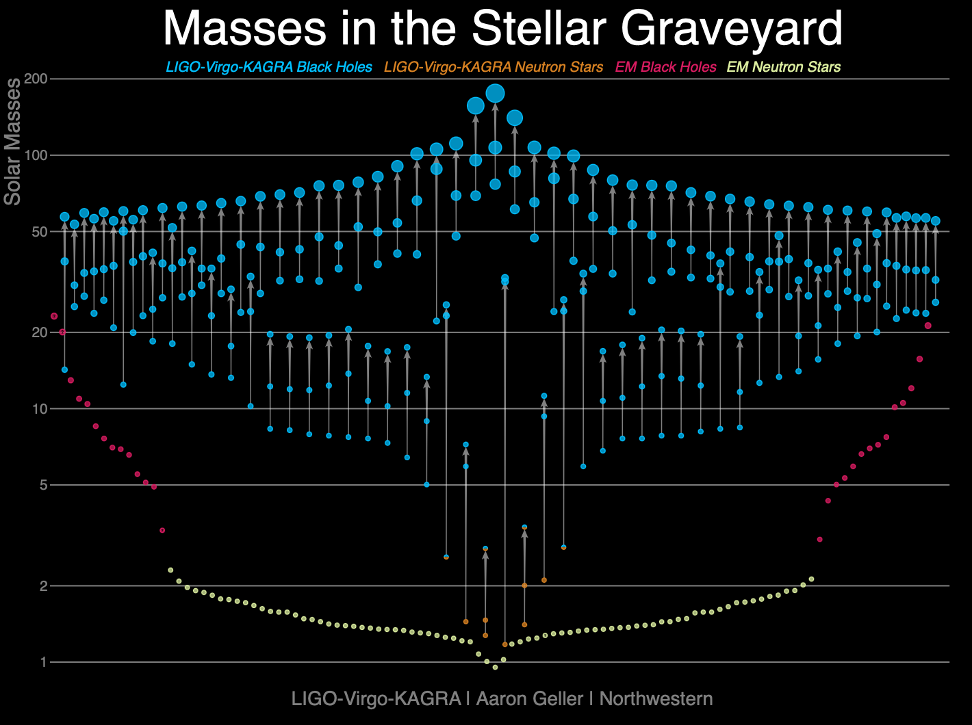
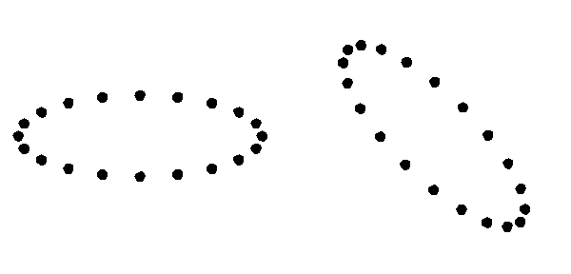
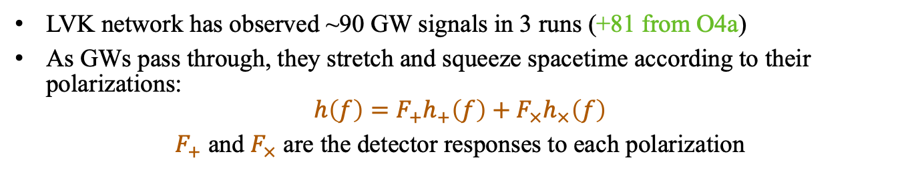
Emission of GWs
Abbott+ (2016)
LVK network has observed ~90 GW signals in 3 runs (+81 from O4a)
As GWs pass through, they stretch and squeeze spacetime according to their polarizations:
$$h\left(f\right)=F_{+}h_{+}\left(f\right)+F_{×}h_{×}\left(f\right)$$
$F_{+}$ and $F_{×}$ are the detector responses to each polarization
04/05/2024
Notes:
GWs are radiative perturbations in gravitational fields predicted by GR.

Slide 4
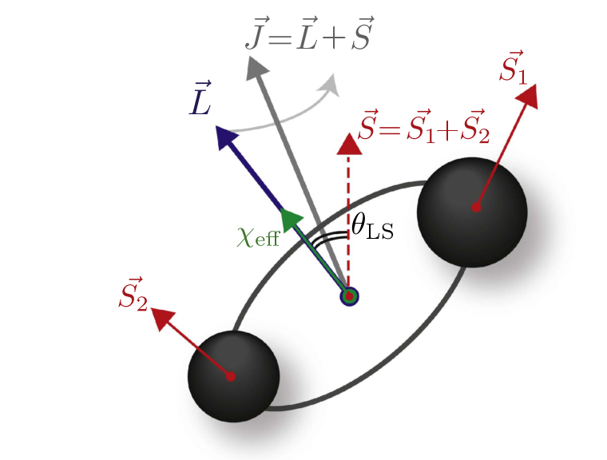
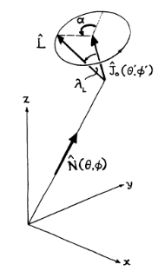
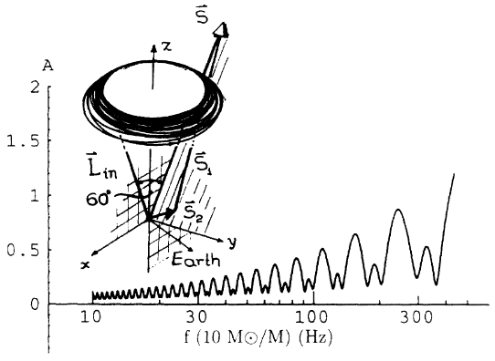
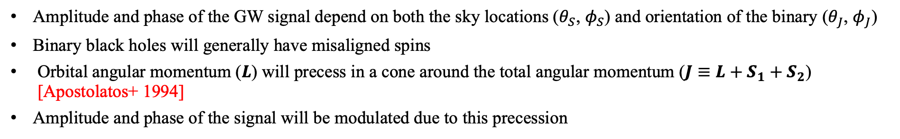

GWs & Precession
$$h\left(f\right)=B(f)e^{iΦ(f)}$$
Rodriguez group @ UNC
Apostolatos+ (1994)
Amplitude and phase of the GW signal depend on both the sky locations ($θ_{S}$, $φ_{S}$) and orientation of the binary ($θ_{J}$, $φ_{J}$)
Binary black holes will generally have misaligned spins
Orbital angular momentum ($L$) will precess in a cone around the total angular momentum ($J≡L+S_{1}+S_{2}$) [Apostolatos+ 1994]
Amplitude and phase of the signal will be modulated due to this precession
Tamanjyot Singh @ April APS, Sacramento
04/05/2024

Slide 5
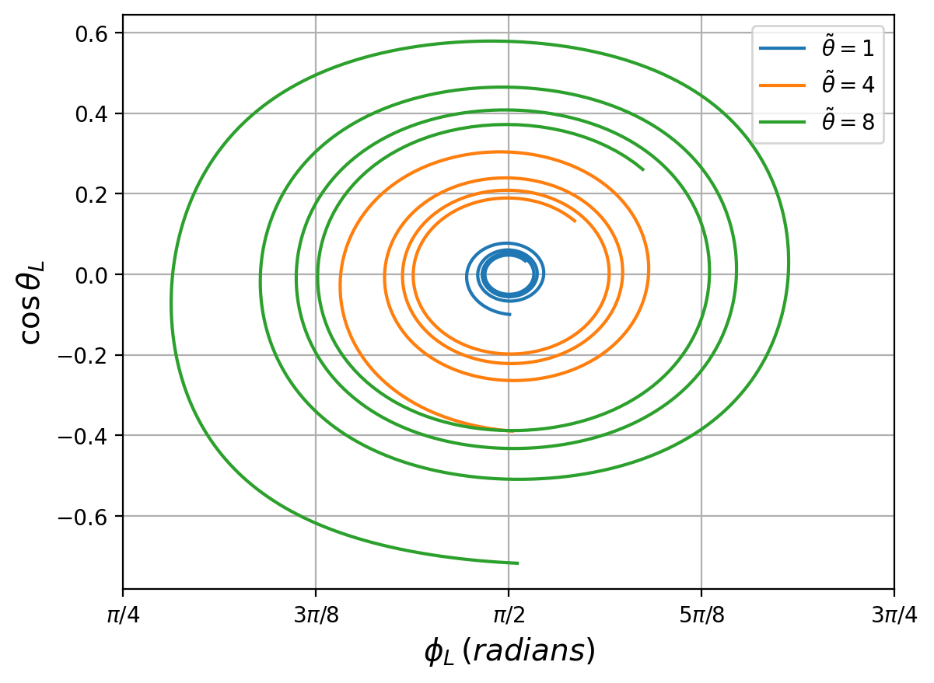
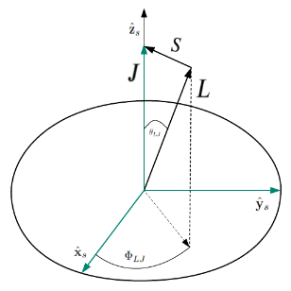
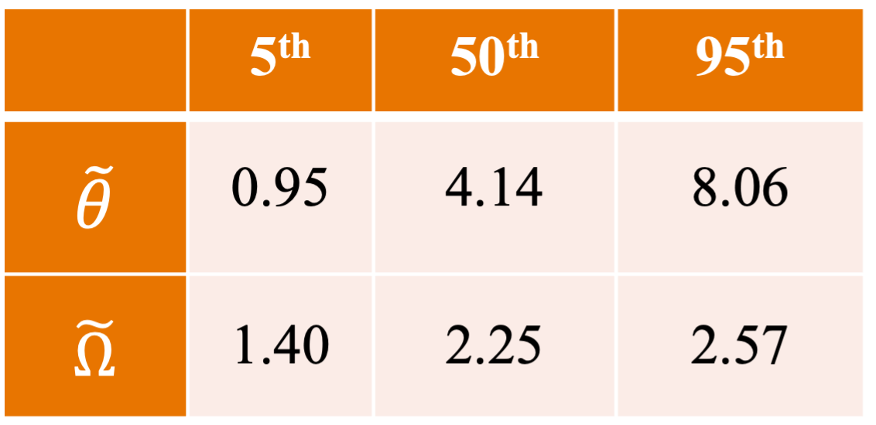
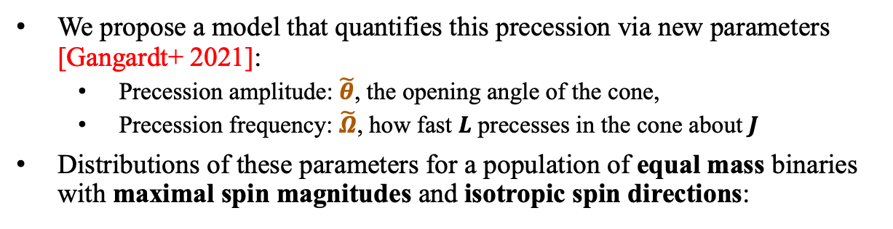
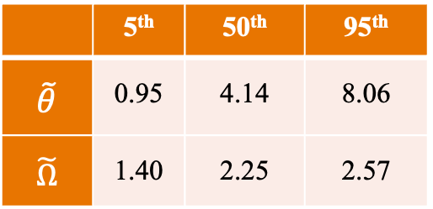
Precession ‘toy’ model
TS+ (in prep)
Edge-on
We propose a model that quantifies this precession via new parameters [Gangardt+ 2021]:
  Precession amplitude: $\tilde{θ}$, the opening angle of the cone,
  Precession frequency: $\tilde{Ω}$, how fast $L$ precesses in the cone about $J$
Distributions of these parameters for a population of equal mass binaries with maximal spin magnitudes and isotropic spin directions:
 | 5th | 50th | 95th
$$\tilde{θ}$$ | 0.95 | 4.14 | 8.06
$$\tilde{Ω}$$ | 1.40 | 2.25 | 2.57
04/05/2024
Notes:
Lowest PN order - Precession is important in the early inspiral phase where essentially the PN approximation is great!
Goal: Can you measure the precession itself?

Slide 6
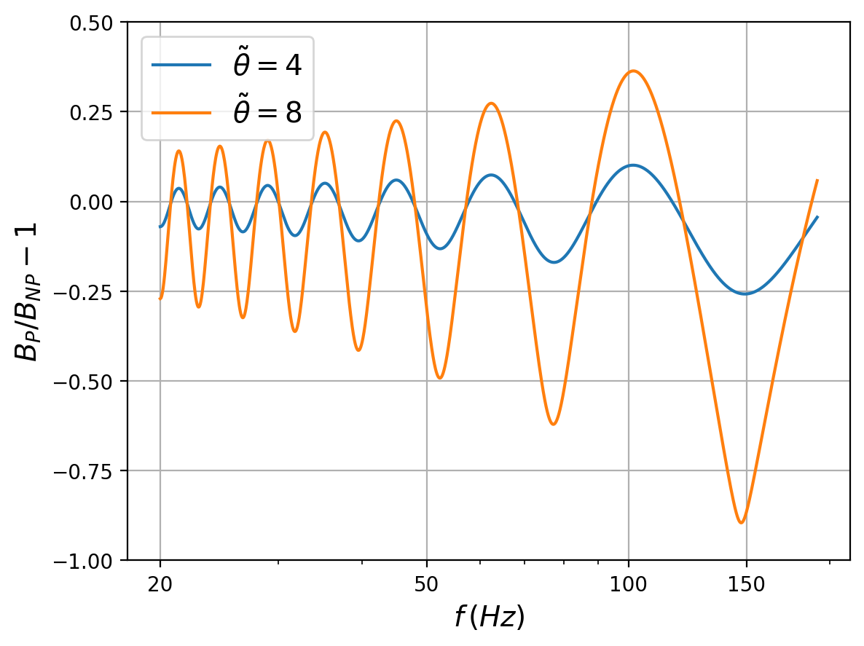
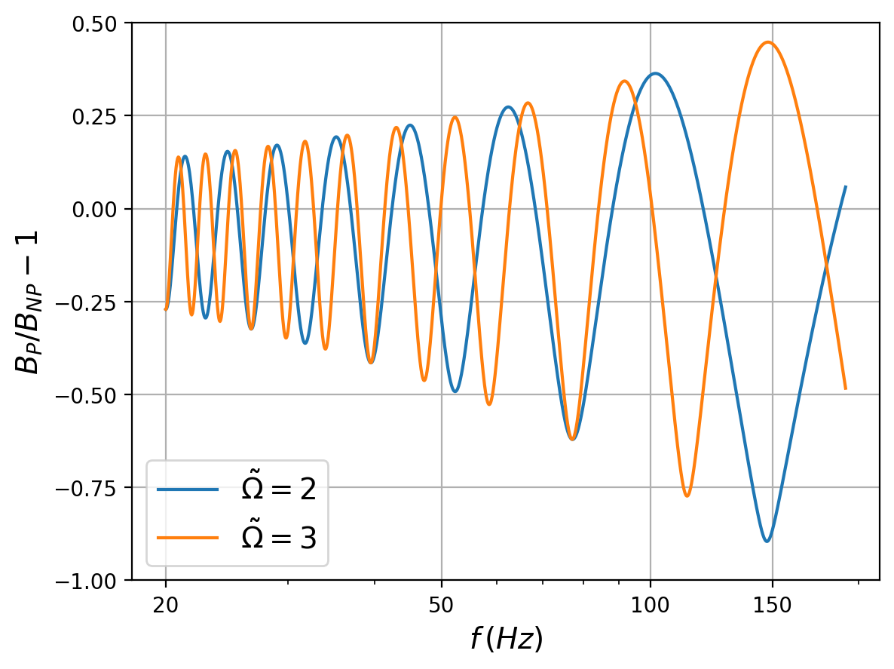
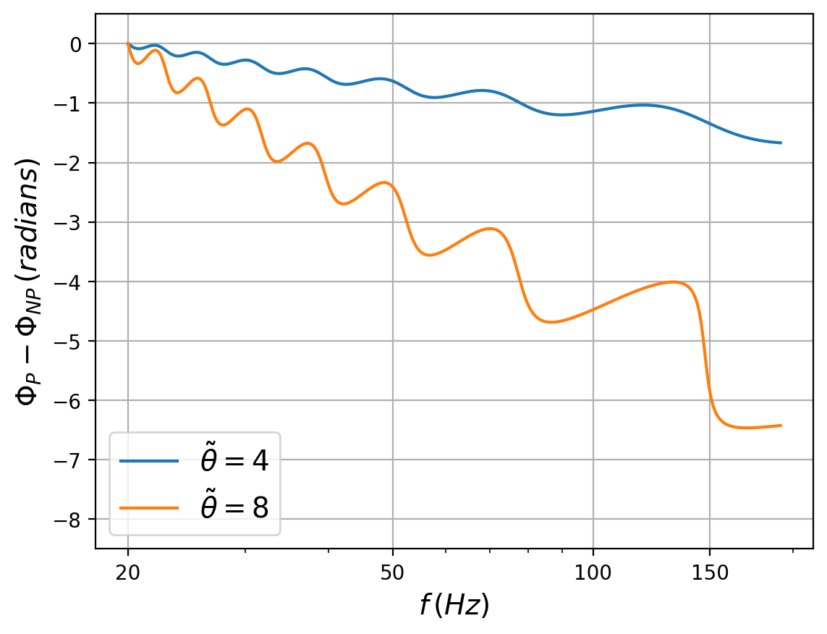
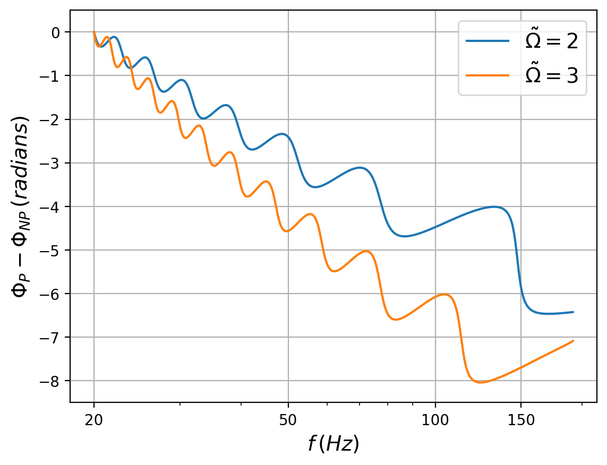

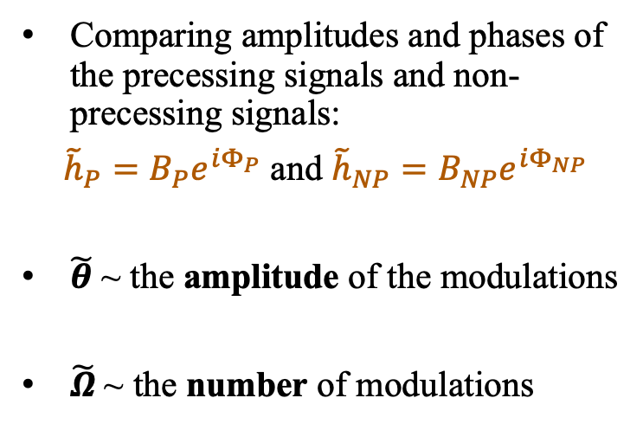
Modulations in amplitude and phase
$q=1$, M$=10M_{⊙}$
Comparing amplitudes and phases of the precessing signals and non-precessing signals:
${\tilde{h}}_{P}=B_{P}e^{iΦ_{P}}$ and ${\tilde{h}}_{NP}=B_{NP}e^{iΦ_{NP}}$
$\tilde{θ}$ ~ the amplitude of the modulations
$\tilde{Ω}$~ the number of modulations
Edge-on
TS+ (in prep)
04/05/2024
Notes:
Modifying the lowest order PN amplitude and phase

Slide 7
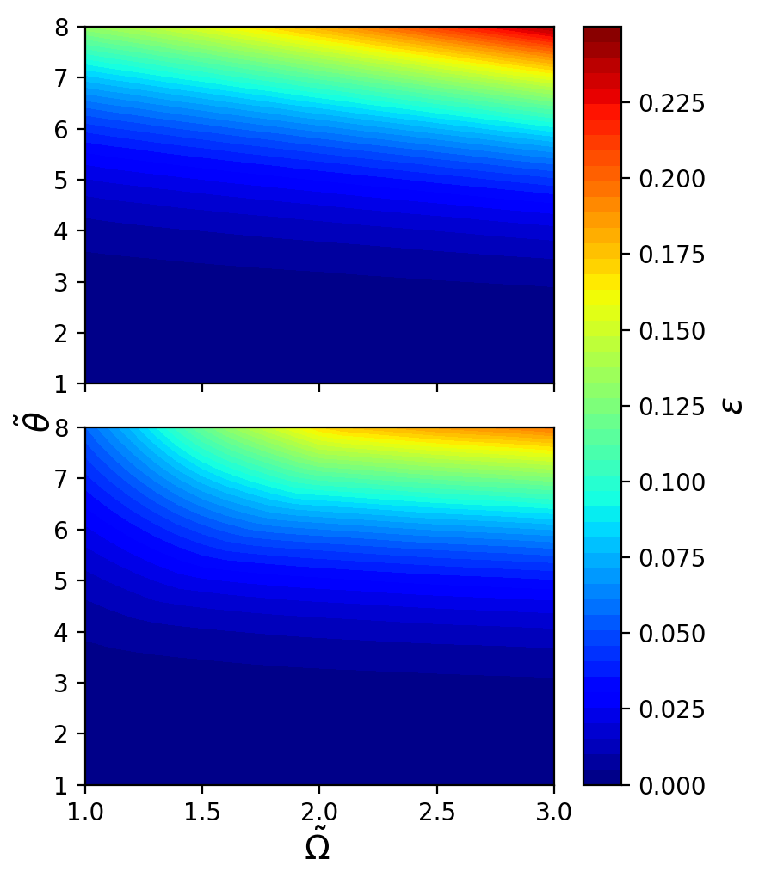
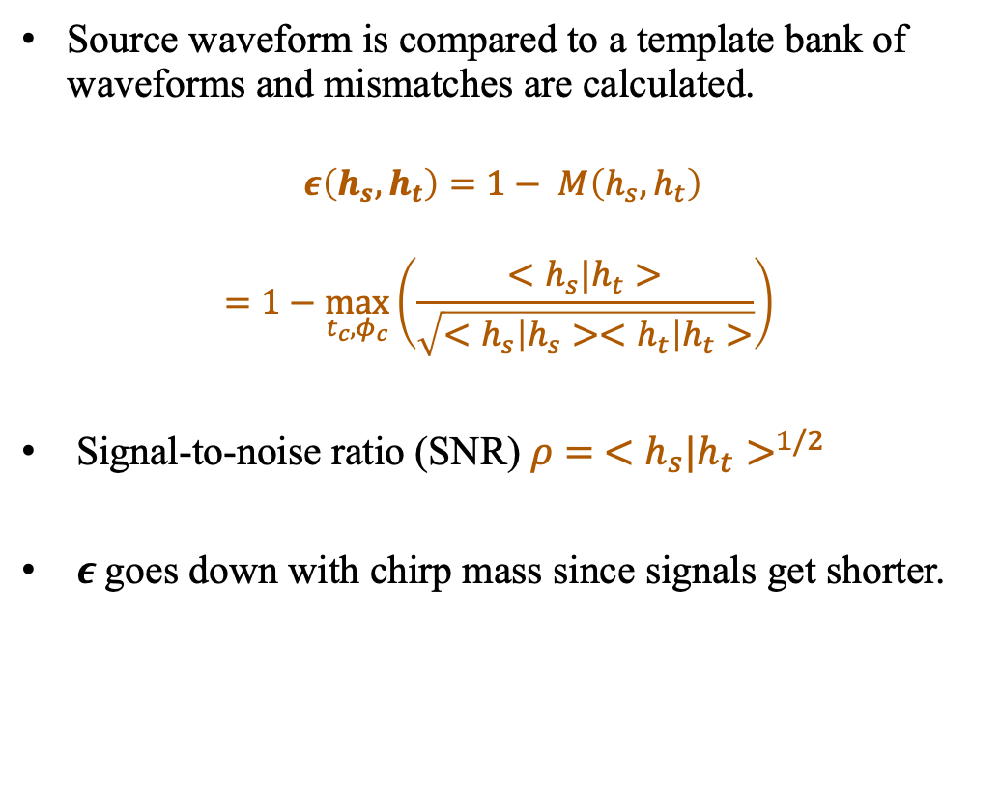


Mismatches
Source waveform is compared to a template bank of waveforms and mismatches are calculated.
$$ε\left(h_{s}, h_{t}\right)=1− M\left(h_{s}, h_{t}\right)$$
$$=1−\max_{t_{c}, φ_{c}}\left(\frac{<h_{s}|h_{t}>}{\sqrt{<h_{s}\left|h_{s}><h_{t}\right|h_{t}>}}\right)$$
Signal-to-noise ratio (SNR) $ρ= {<h_{s}|h_{t}>}^{1/2}$
$ε$goes down with chirp mass since signals get shorter.
$$\text{M}=10M_{⊙}$$
$$\text{M}=20M_{⊙}$$
Edge-on
TS+ (in prep)
04/05/2024

Slide 8
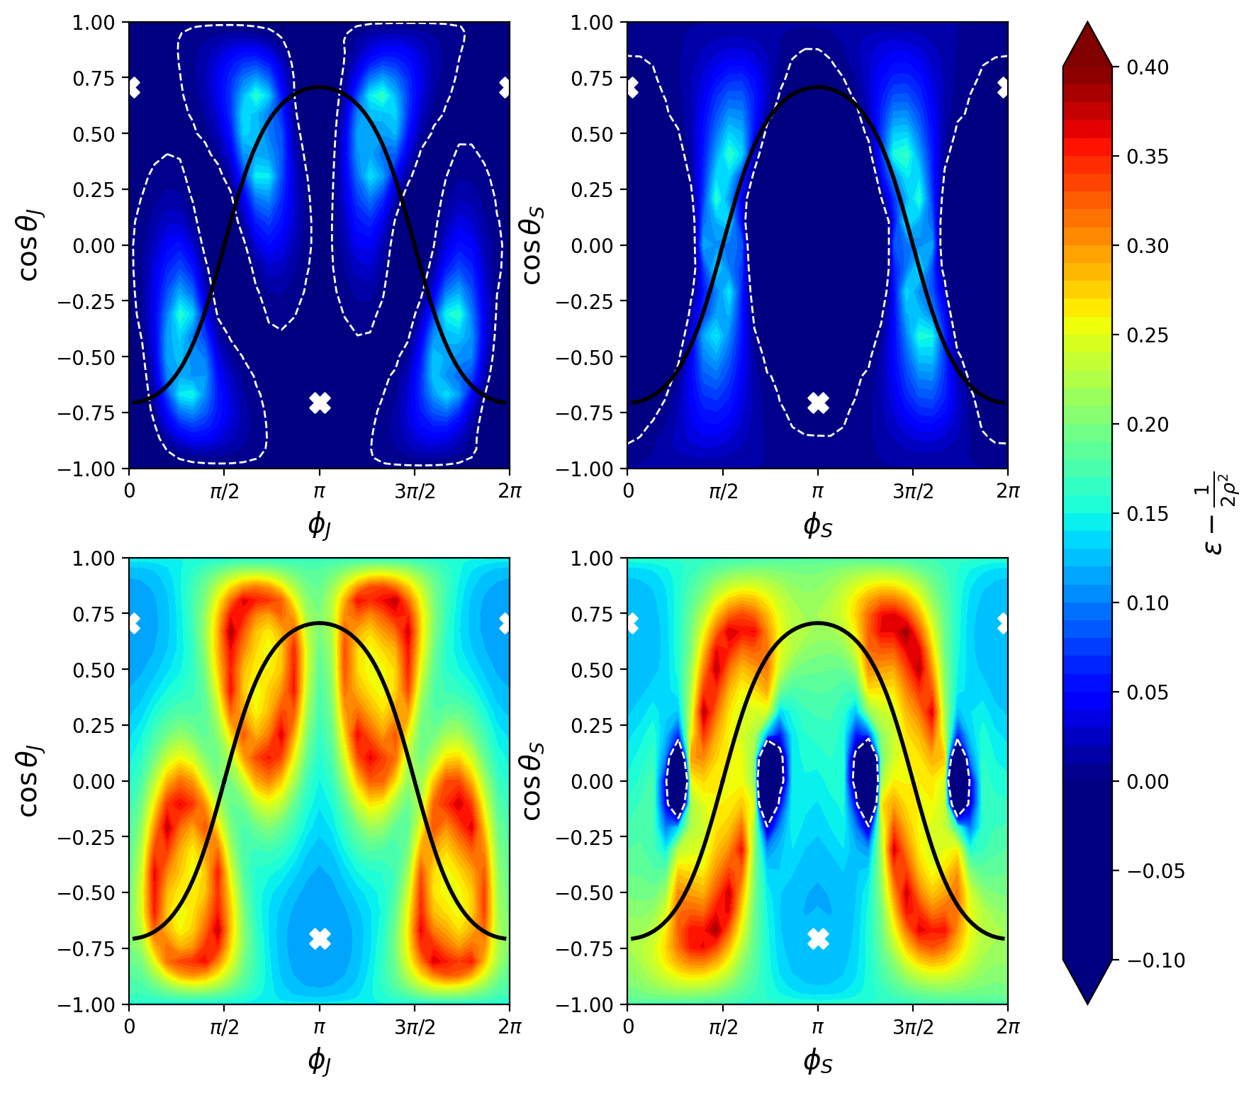
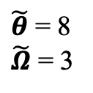
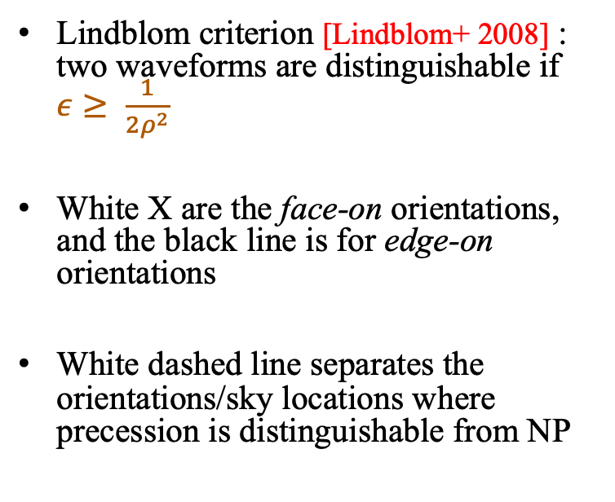
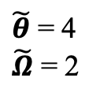





Distinguishability
$θ_{s}=π/4, φ_{s}=0$
$$θ_{J}=π/4, φ_{J}=0$$
$q=1$, M$=10M_{⊙}$
Lindblom criterion [Lindblom+ 2008] : two waveforms are distinguishable if $ε≥ \frac{1}{2ρ^{2}}$
White X are the face-on orientations, and the black line is for edge-on orientations
White dashed line separates the orientations/sky locations where precession is distinguishable from NP
$\tilde{θ}$ = 4
$\tilde{Ω}$ = 2
$\tilde{θ}$ = 8
$\tilde{Ω}$ = 3
$$\tilde{h}\left(f\right)=F_{+}{\tilde{h}}_{+}\left(f\right)+F_{×}{\tilde{h}}_{×}\left(f\right)$$
TS+ (in prep)
$$D_{L}=1.5 Gpc$$
04/05/2024
Notes:
redshifted chirp mass of 10M.

Slide 9
Conclusions & future work
The precession model presented provides a geometrical framework for misaligned spins and the effects of such misalignments become more intuitive with the parameters proposed.
Precession is distinguishable given the mismatches b/w precessing and non-precessing signals.
High enough SNR ensures encapsulation of a lot of source features, future LVK network observation runs with promising sensitivities can help in the certainty of such features.
Future work:
  This simplistic ‘toy’ model of precession may have perturbations due to the nutation of L around J. [Gangardt+ 2021]
  Multiple detectors can provide better observational constraints to precessional effects.
With planned/proposed 3G detectors we can get better detector sensitivities and longer frequency bands to have a better chance of observing precession.
04/05/2024
Notes:
Lowest PN order - Precession is important in the early inspiral phase where essentially the PN approximation is great!
Goal: Can you measure the precession itself?

Slide 10
Thank you
This research was supported by NSF grants PHY-2011977 and PHY-2309320
Tamanjyot Singh @ April APS, Sacramento
Contact: tamanjyot@utdallas.edu
10
Image credit: LIGO/Caltech/MIT/Sonoma State (Aurore Simonnet)

Slide 11
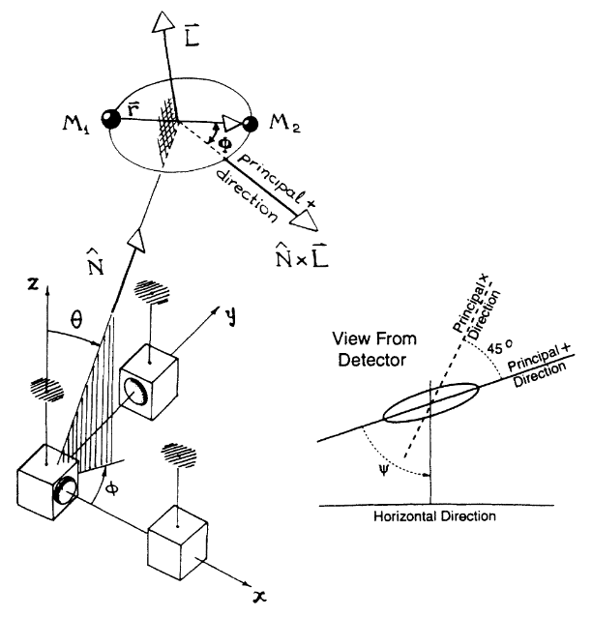



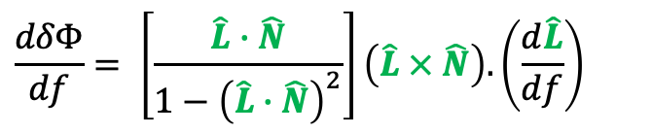

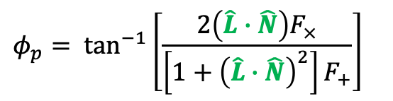
Precession signal
$${\tilde{h}}_{+}\left(f\right)=Af^{−7/6}[1+{(\hat{L}∙\hat{N})}^{2}]e^{iΨ}$$
$${\tilde{h}}_{×}\left(f\right)=−2iAf^{−7/6}(\hat{L}∙\hat{N})e^{iΨ}$$
$$h\left(f\right)=F_{+}h_{+}\left(f\right)+F_{×}h_{×}\left(f\right)$$
$$h\left(f\right)=B(f)e^{iΦ(f)}$$
$$B\left(f\right)=Af^{−7/6}{\left\{4{\left(\hat{L}∙\hat{N}\right)}^{2}{F_{×}}^{2}+{\left[1+{\left(\hat{L}∙\hat{N}\right)}^{2}\right]}^{2}{F_{+}}^{2}\right\}}^{1/2}$$
$$Φ\left(f\right)=Ψ\left(f\right)− φ_{p} −2δΦ$$
$$φ_{p}= \tan^{−1}\left[\frac{2\left(\hat{L}∙\hat{N}\right)F_{×}}{\left[1+{\left(\hat{L}∙\hat{N}\right)}^{2}\right]F_{+}}\right]$$
$$\frac{dδΦ}{df}= \left[\frac{\hat{L}∙\hat{N}}{1−{\left(\hat{L}∙\hat{N}\right)}^{2}}\right]\left(\hat{L} × \hat{N}\right).\left(\frac{d\hat{L}}{df}\right)$$
Apostolatos+ (1994)
04/05/2024

Slide 12
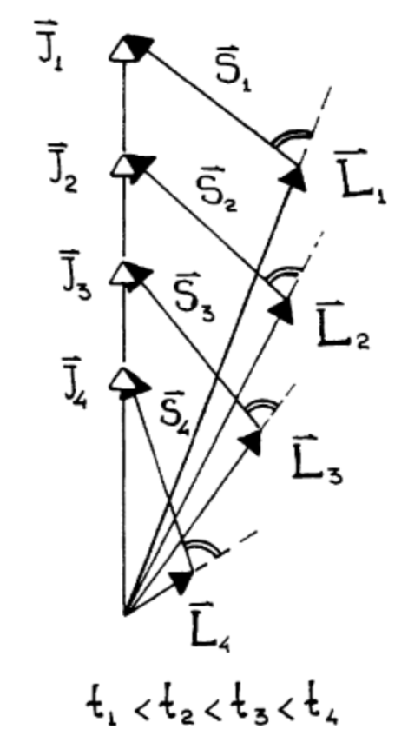
L spiraling out as binary merges
TS+ (in prep)
Apostolatos+ (1994)
04/05/2024

Slide 13
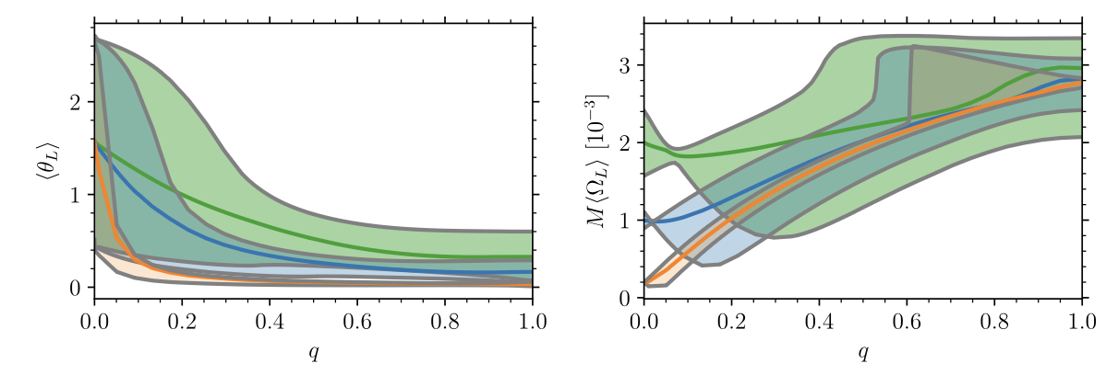
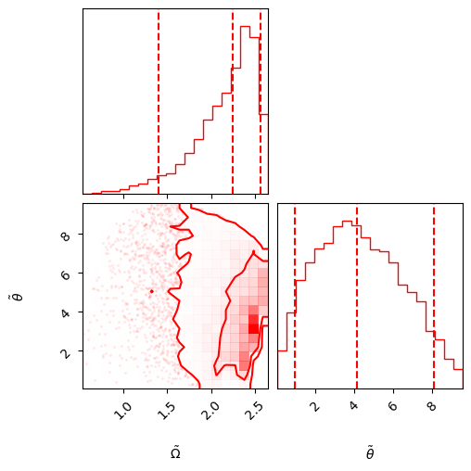
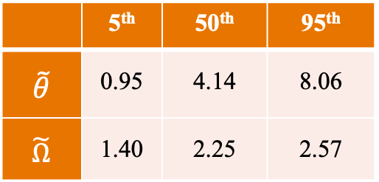
Distributions of precession parameters
Gangardt+ (2021)
 | 5th | 50th | 95th
$$\tilde{θ}$$ | 0.95 | 4.14 | 8.06
$$\tilde{Ω}$$ | 1.40 | 2.25 | 2.57
TS+ (in prep)
04/05/2024

